Slide 1


Global Climate Change
Week 5 – The Evidence Base for Climate Change
Dr Thomas Bannan
Thomas.Bannan@Manchester.ac.uk

Slide 2


Global Climate Change - 2026
Week 1 – Introduction to climate change and its impacts (5th Feb)
Week 2 – Natural climate variability (12th Feb)
Week 3 – Radiation Law/Greenhouse Effect/Radiative forcing/feedbacks (19th Feb)
Week 4 – Anthropogenic impacts (26th Feb)
Week 5 – The Evidence Base for Climate Change (5th March)
Week 6 – Mid Unit Test (10th March)
Week 7 – Climate Models (19th March)
Week 8 – Climate Change Adaptation (26th March)
Week 9 – Effects of Climate Change: Case Studies (23rd April)
Week 10 – Climate Change Mitigation (30th April)
Week 11 – Revision Lecture (7th May)
Comments/Questions

Slide 3

Today’s class
  Part 1: Lecture and Workshops (50 mins)
  Part 2: Q/A (10 mins)
  Part 3: Full workshop (50 mins)

Slide 4

Intended Learning Outcomes
By the end of the week you will be able to:
Outline the different sources of observational data for temperature and carbon dioxide, explaining over what timescales they can be used.
Describe the different sources of evidence supporting our understanding that human impacts are driving increased temperatures.
Describe the different sources of uncertainty in our understanding of climate change, and use these to explain which aspects of climate change we understand better and why.

Slide 5
“How do we know climate change is real — and how do we know it’s us?”
Is it changing? Observations
Is it unusual? Context from paleoclimate (week 1 and 2)
Is it us? physics (week 3) + models (week 7) + measurements = attribution

Slide 6
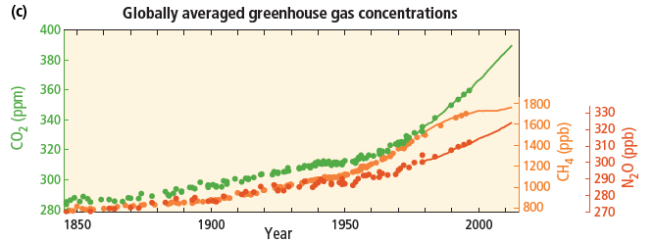
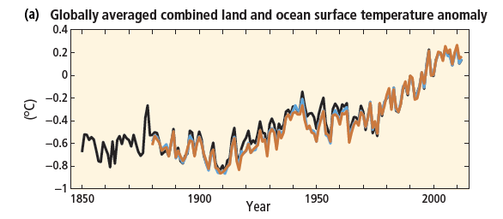
Anthropogenic climate change measured

Slide 7
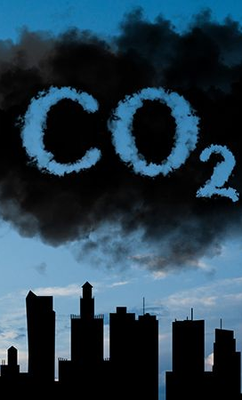
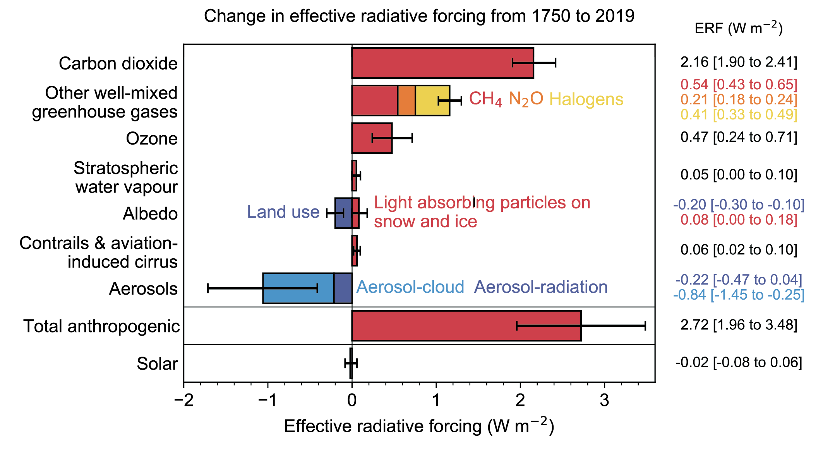
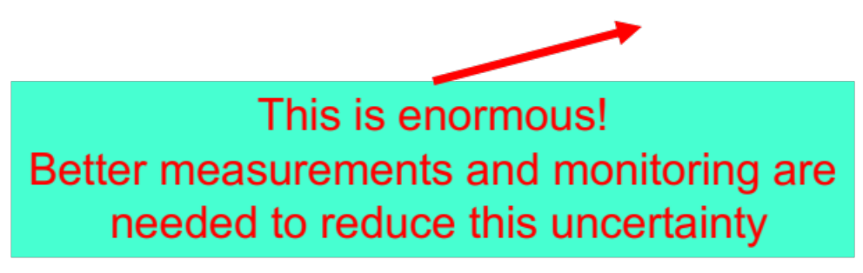
Measurements

Slide 8
Measurements
CO₂
Direct measurements (1958 – present)
Ice cores (100’000s years ago)
Proxies (10s millions years ago)
Temperature
Direct measurements (from 1850) + satellites (from 1979)
Proxies:
  Tree rings (~500 – 2000 years)
  Oxygen isotopes in ice cores (100’000s years ago)
  Isotopes in lake and ocean sediments (millions of years)
The further back you go you get lower accuracy, but also lower temporal resolutions.
Notes:
The further back you go you get lower accuracy, but also lower temporal resolutions.
Proxies in general have large uncertainties, as often other factors affect any given proxy as well.

Slide 9
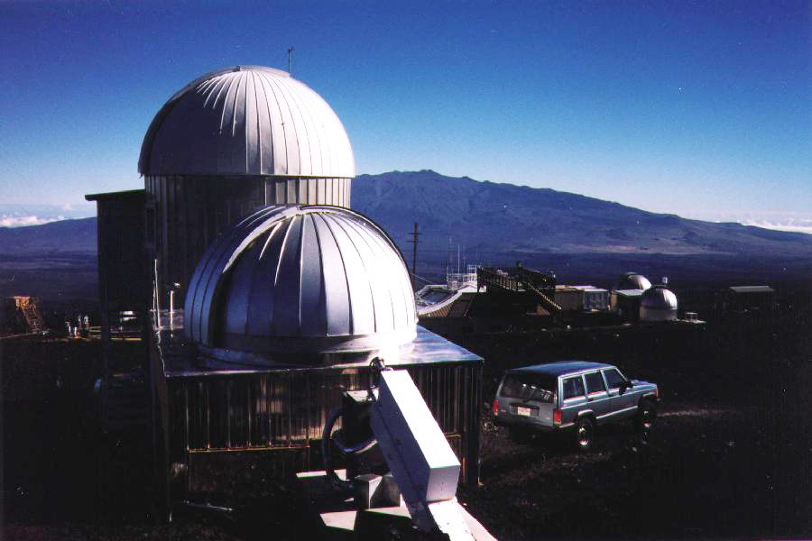
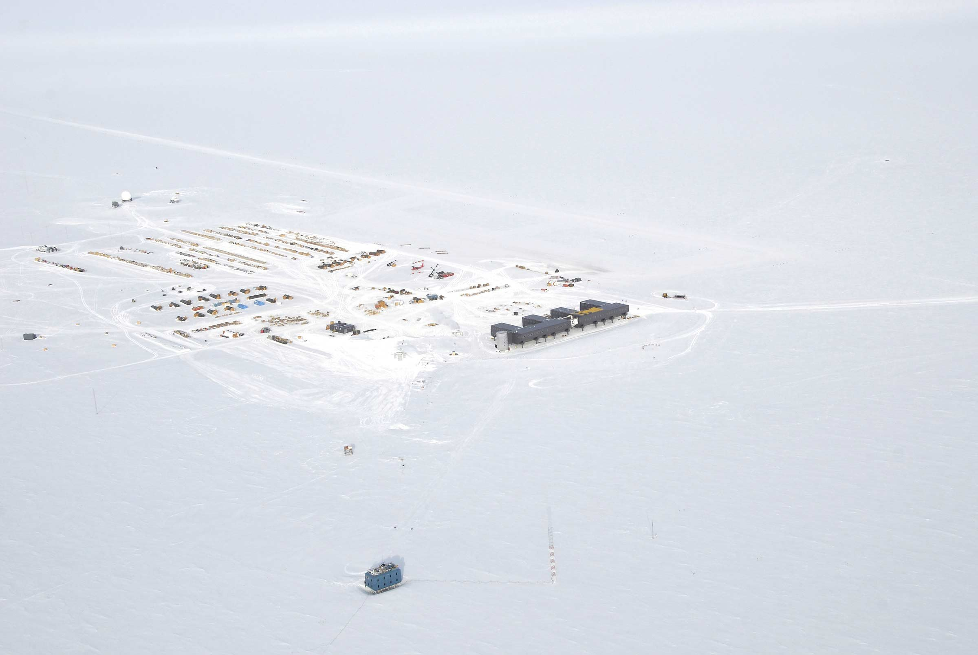
CO₂ Measurements
Mauna Loa Observatory (MLO)
South Pole Atmospheric Research Observatory (SPO)
Direct measurements (from 1958)

Slide 10
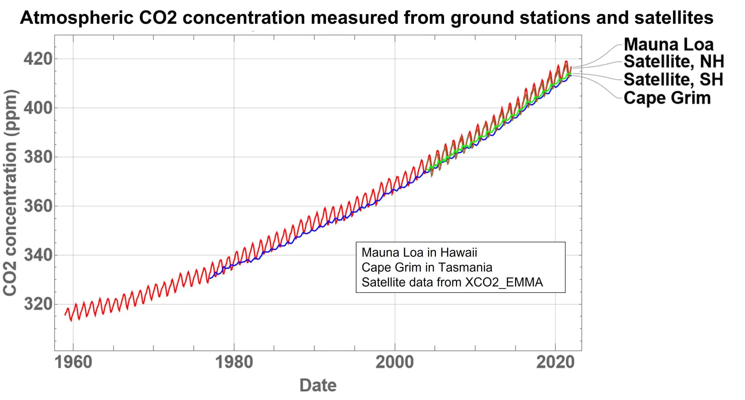
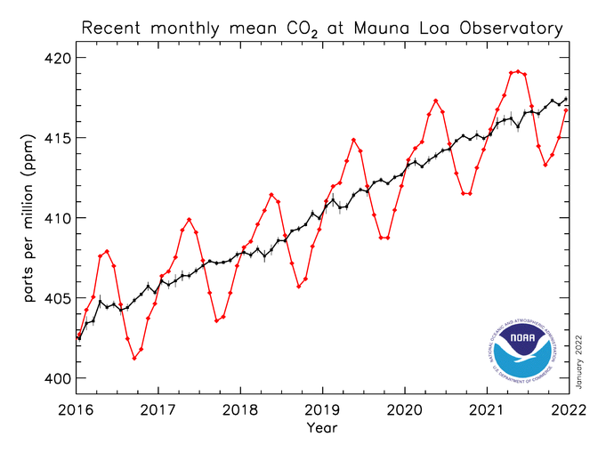
CO₂ Measurements
Direct measurements (from 1958)
Mauna Loa Observatory (MLO)

Slide 11
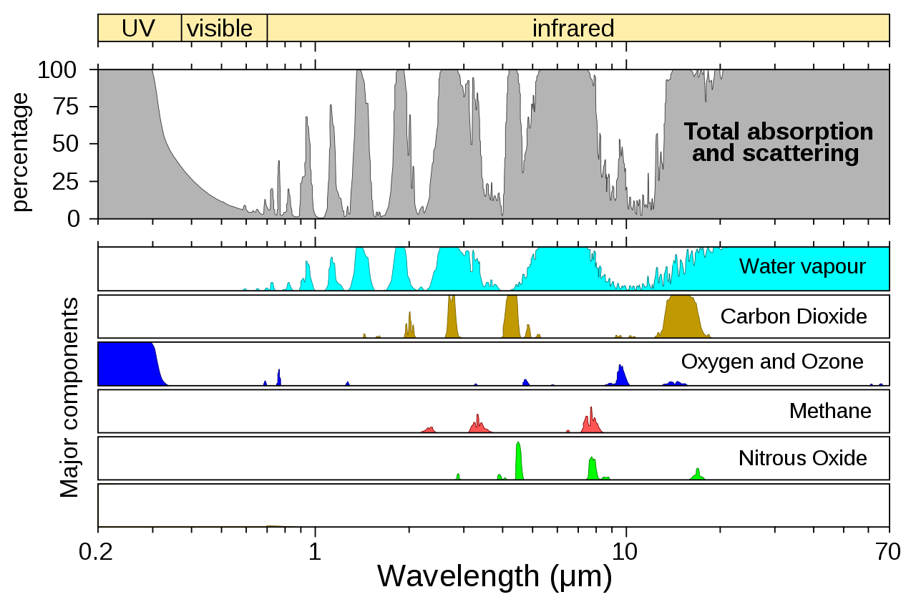
Energy Balance - Key Gasses
These properties can be used to make measurements of their concentrations

Slide 12
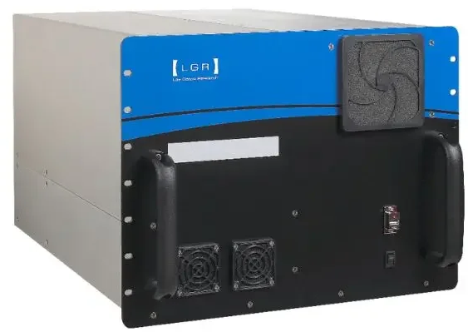
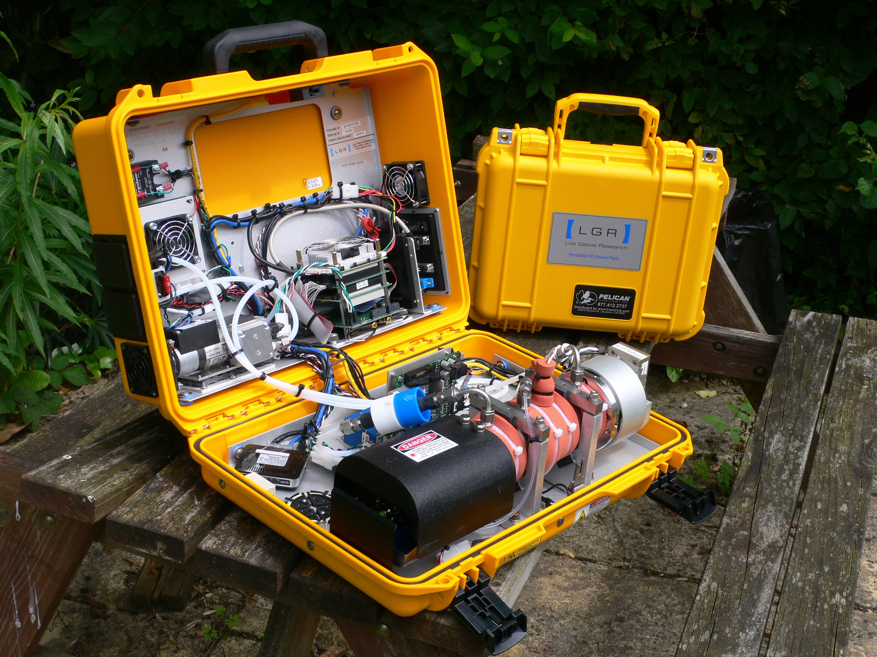
Measurements
Greenhouse gases absorb radiation at specific wavelengths (unique spectral “fingerprints” in the infrared).
Absorption strength is proportional to concentration (Beer–Lambert law), allowing precise quantification of gas amounts.
Instruments measure how much radiation is absorbed along a known path length
Different gases absorb at different wavelengths, allowing CO₂, CH₄, H₂O and others to be measured independently.

Slide 13
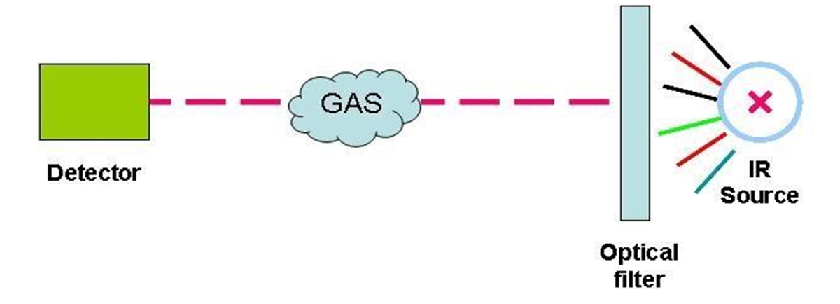
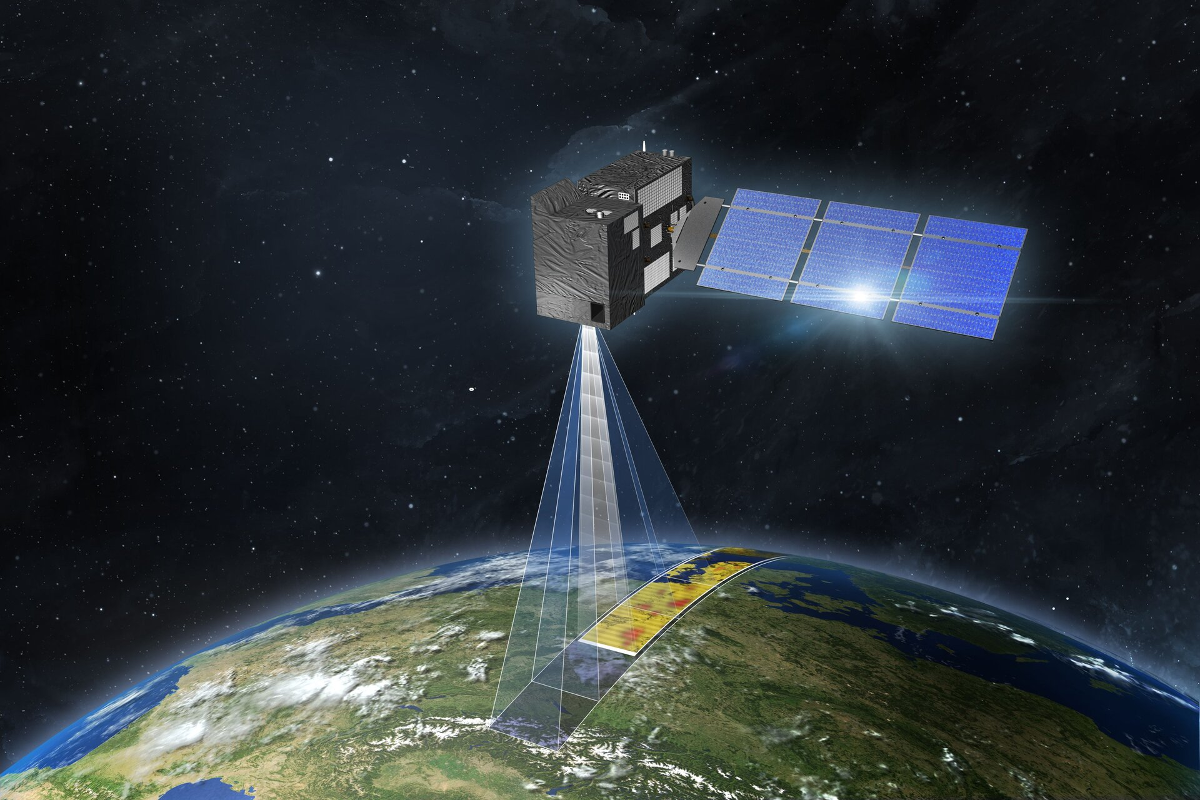
Measurements
In situ ground measurements
Air is drawn into an instrument cell.
The gas passes through a chamber of fixed length (e.g. 10–100 cm).
Infrared light passes through that chamber.
The instrument measures how much light is absorbed.
Because the chamber length is known precisely, concentration can be calculated directly.
Here the path length is the length of the measurement cell.
Open-path / remote sensing from ground
A beam may travel:
From instrument → reflector → back to detector
The distance between them is measured accurately, so total path length is known.
Satellites
Radiation travels from Earth’s surface → through the atmosphere → to the satellite.
Radiative transfer models account for pressure, temperature, and atmospheric layering.
The effective path length is calculated

Slide 14
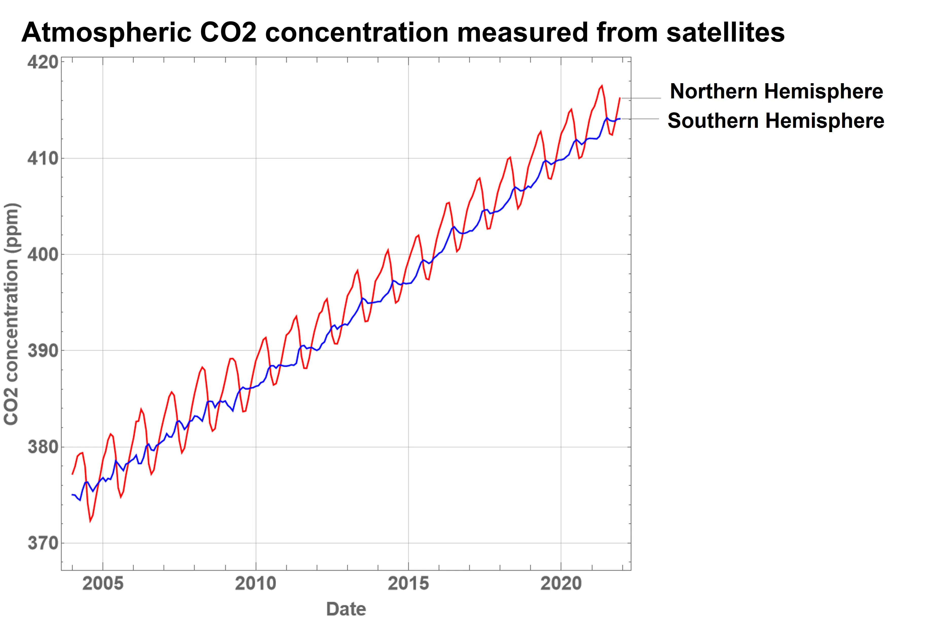
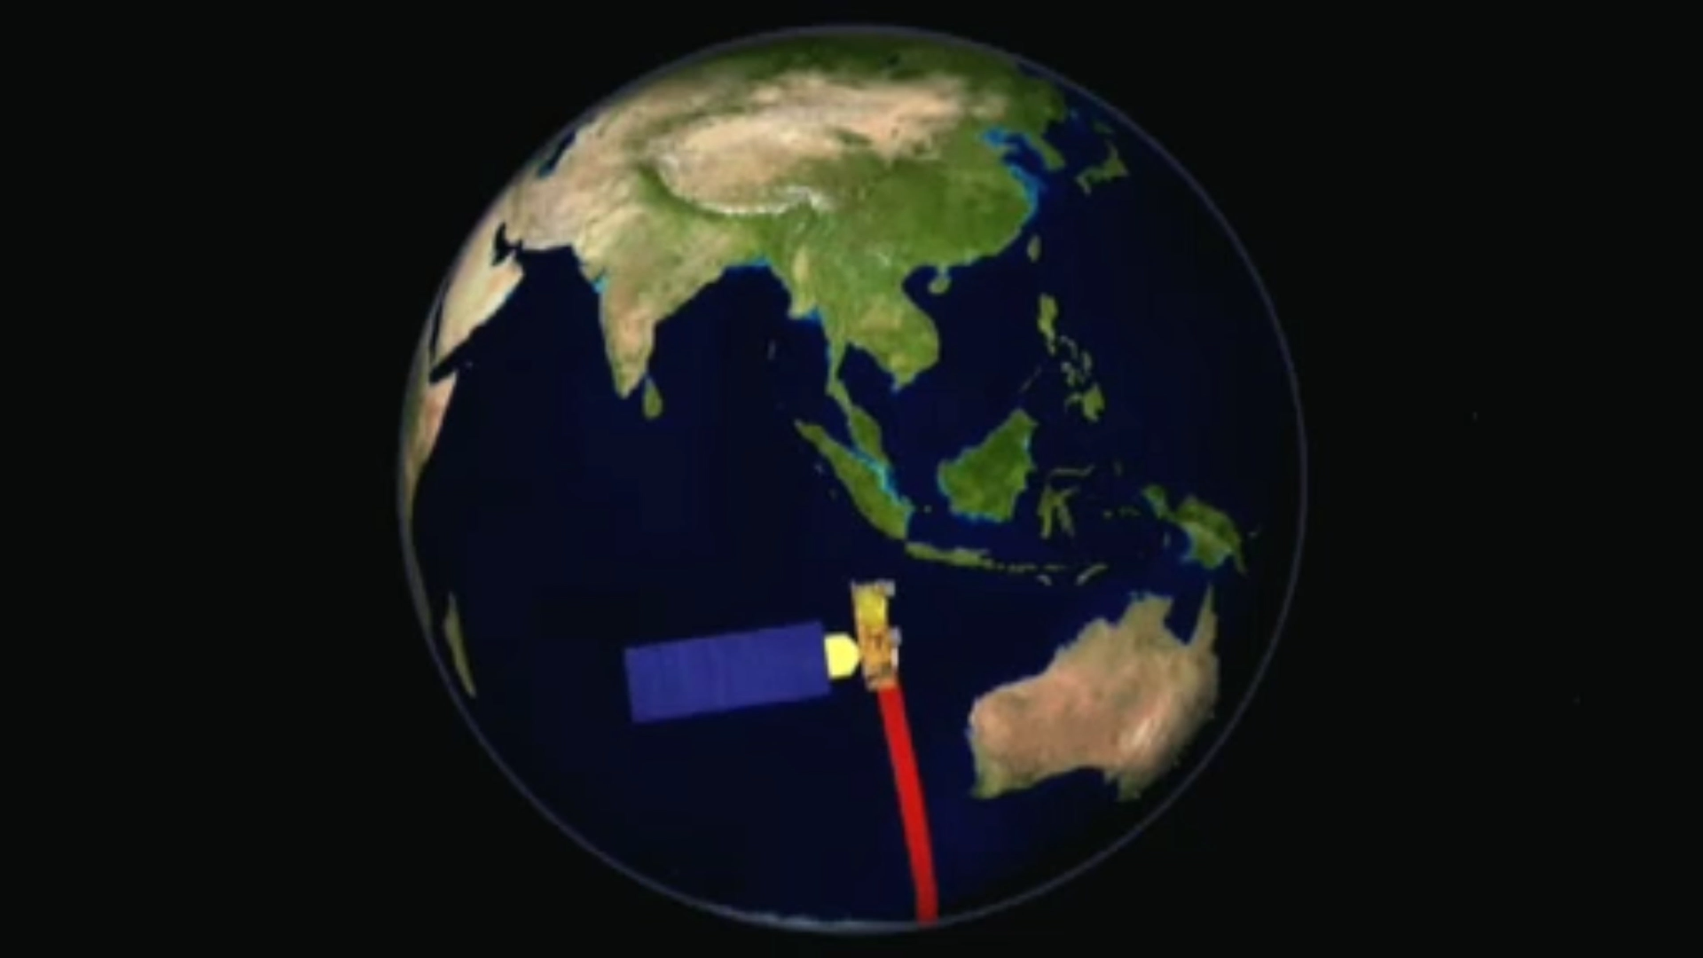
CO₂ Measurements From Satellites
The famous ‘saw-tooth’ line of the graph reflects the seasons: there are more trees and plants in the northern hemisphere than in the southern hemisphere, so globally the world’s land areas ‘breathe in’ during the northern spring/summer and out during the northern autumn/winter.

Slide 15
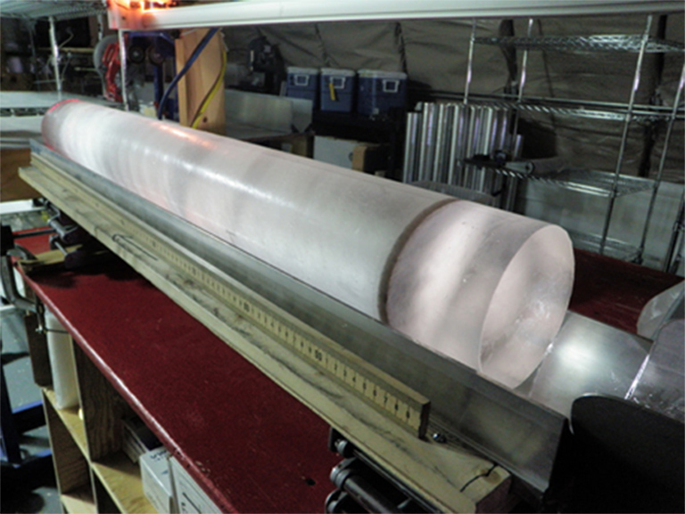
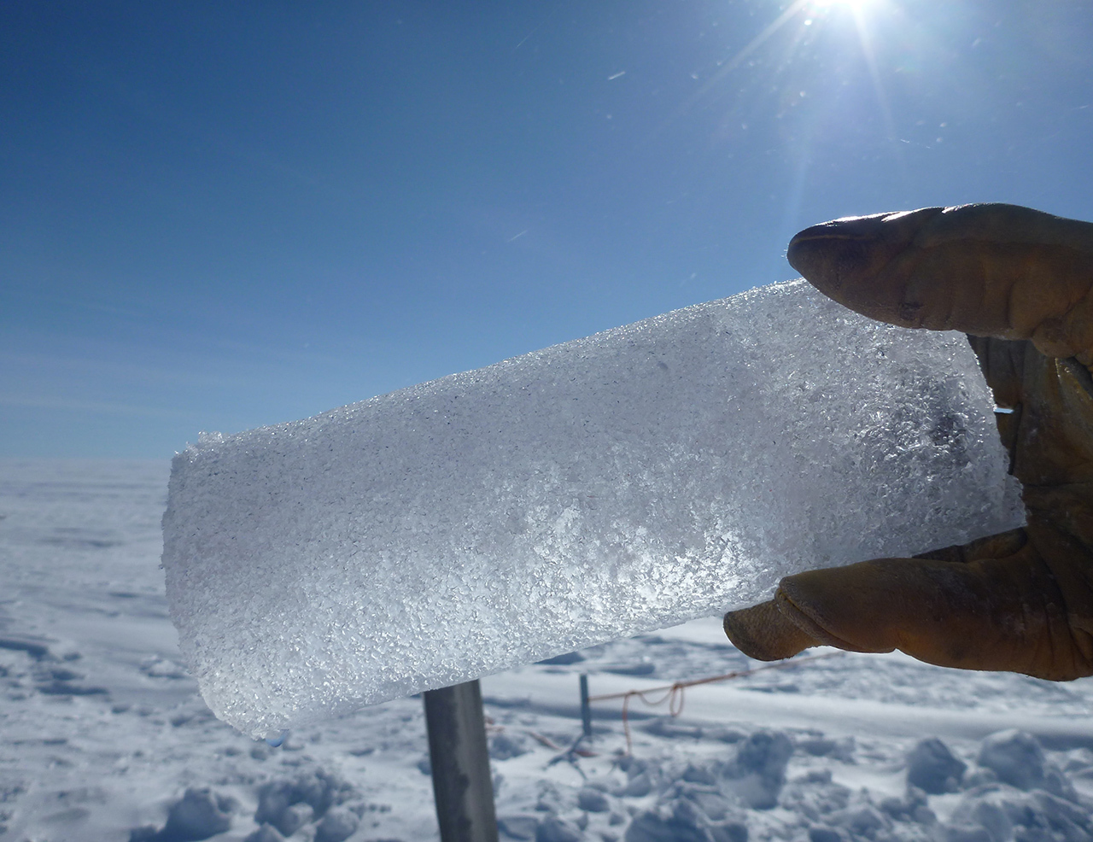

CO₂ Measurements
Ice cores (100’000s years ago)
Ice cores preserve past atmospheric CO₂ in air bubbles trapped as snow compacts into ice, providing a direct record of past atmospheres.
These records extend back ~800,000 years, allowing long-term CO₂–climate relationships to be studied.
Temporal resolution decreases with depth as ice flow and firn diffusion smooth the signal, averaging CO₂ over longer time periods.
The age of the gas is younger than the surrounding ice, creating a gas–ice age offset that must be corrected for

Slide 16
CO₂ Measurements
Direct measurements (from 1958)
Ice cores (100’000s years ago)

Slide 17
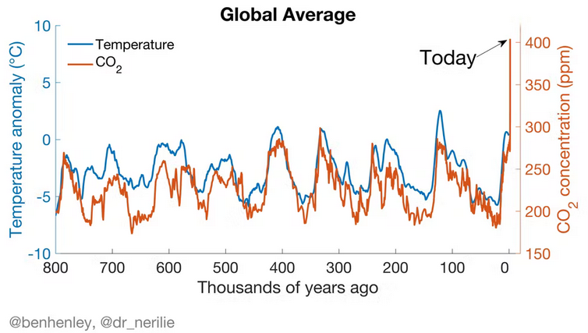
CO₂ Measurements
Direct measurements (from 1958)
Ice cores (100’000s years ago)
Ice cores show that during the past 800,000 years CO₂ fluctuated only within narrow constraints. The current level of 420ppm was last seen millions of years ago, when the world looked radically different and was much hotter.
Evidence for being man-made: CO₂ from fossil fuels contains no ¹⁴C - unlike the ‘background’. This impacts the atmospheric ^14C/^12C ratio.

Slide 18
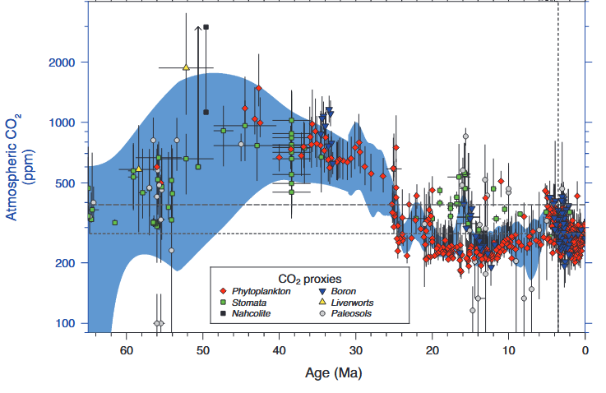
CO₂ Measurements
Direct measurements (1958 – present)
Ice cores (100’000s years ago)
Proxies (10s millions years ago)
What is a climate proxy?
An environmental indicator that can be related to a climatic variable.
Individual proxies are noisy and uncertain, but taken together they robustly show that atmospheric CO₂ was much higher in the past and has declined over tens of millions of years, closely linked to long-term climate cooling.

Slide 19
CO₂ Measurements
Direct measurements (1958 – present)
Ice cores (100’000s years ago)
Proxies (10s millions years ago)
Climate Proxy Examples
Phytoplankton (red diamonds) -CO₂ inferred from carbon isotopes in marine phytoplankton; reflects how carbon uptake varies with ambient CO₂ but is influenced by growth rate and nutrient availability.
Stomata (green squares) -Based on the density of stomata on fossil leaves; plants form fewer stomata at higher CO₂, but results depend on species and environmental stress.
Boron isotopes (blue triangles) -Uses the pH sensitivity of boron isotopes in marine carbonates to infer seawater pH, and hence atmospheric CO₂; sensitive to assumptions about ocean chemistry.
Paleosols (grey circles) - CO₂ estimated from carbon isotopes in ancient soils; integrates atmospheric CO₂ over long timescales but is influenced by soil respiration and climate.

Slide 20
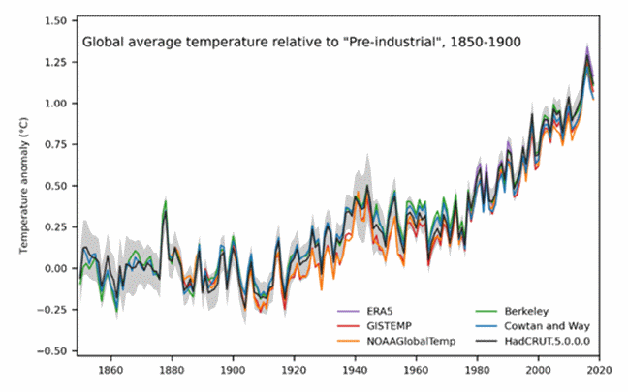
Temperature Measurements
Direct measurements (from 1850)
Satellites (from 1979)
Tens of thousands of temperature observations are taken across the globe each day, both on land and at sea.
Sea surface temperature observations come from buoys deployed across the world's oceans and ships in the Voluntary Observing Ship Programme.
Together they take around 1.5 million observations each month.
The temperature over land comes from about 1,300 observing stations each month.
Stations take daily readings and use them to create a monthly average, which is then sent off for use by climate researchers.

Slide 21

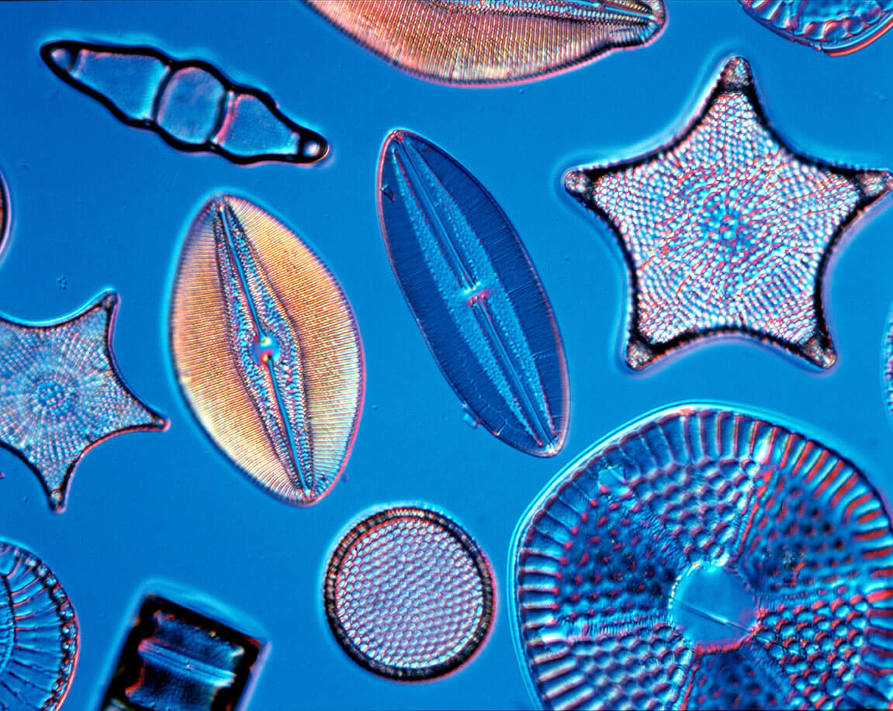
Temperature Measurements
Direct measurements (from 1850)
Satellites (from 1979)
Proxies:
Tree rings (~500 – 2000 years)
Oxygen isotopes in ice cores (100’000s years ago)
Isotopes in lake and ocean sediments (millions of years)

Slide 22
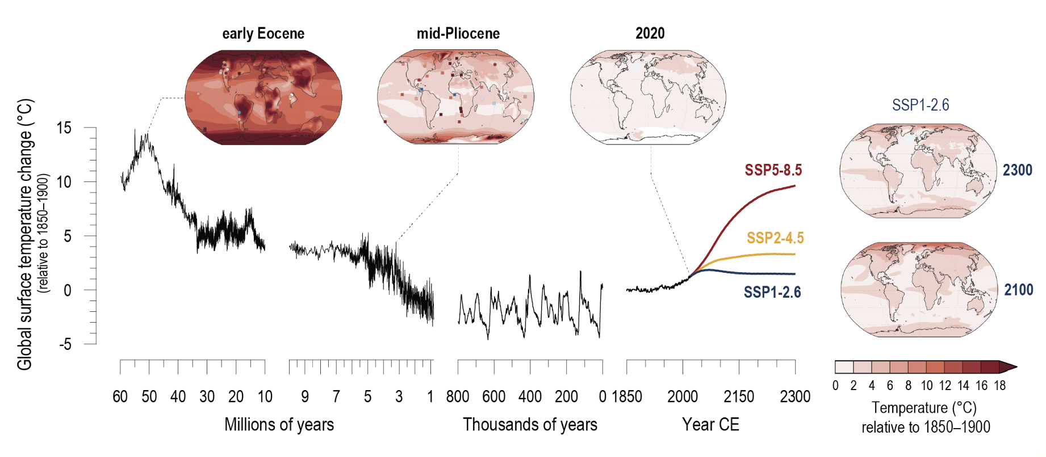
Temperature Measurements: last 6 million years

Slide 23
Temperature Measurements: Today
The Evidence Key Points from WMO 2024
The past ten years 2015-2024 are now the ten warmest years on record
We have likely seen the first calendar year with a global mean temperature of more than 1.5°C above the 1850-1900 average
The evidence for this is based on SIX international datasets which reach this conclusion.
2024 saw exceptional land and sea surface temperatures and ocean heat increases.
The Evidence Update from WMO January 2025
The global average surface temperature was 1.55 °C (with a margin of uncertainty of ± 0.13 °C) above the 1850-1900 average, according to WMO’s analysis of the six datasets.
It is likely that we have just experienced the first calendar year with a global mean temperature of more than 1.5°C above the 1850-1900 average.
Long-term temperature goal of the Paris Agreement 1.5 °C not yet “dead” but in grave danger

Slide 24
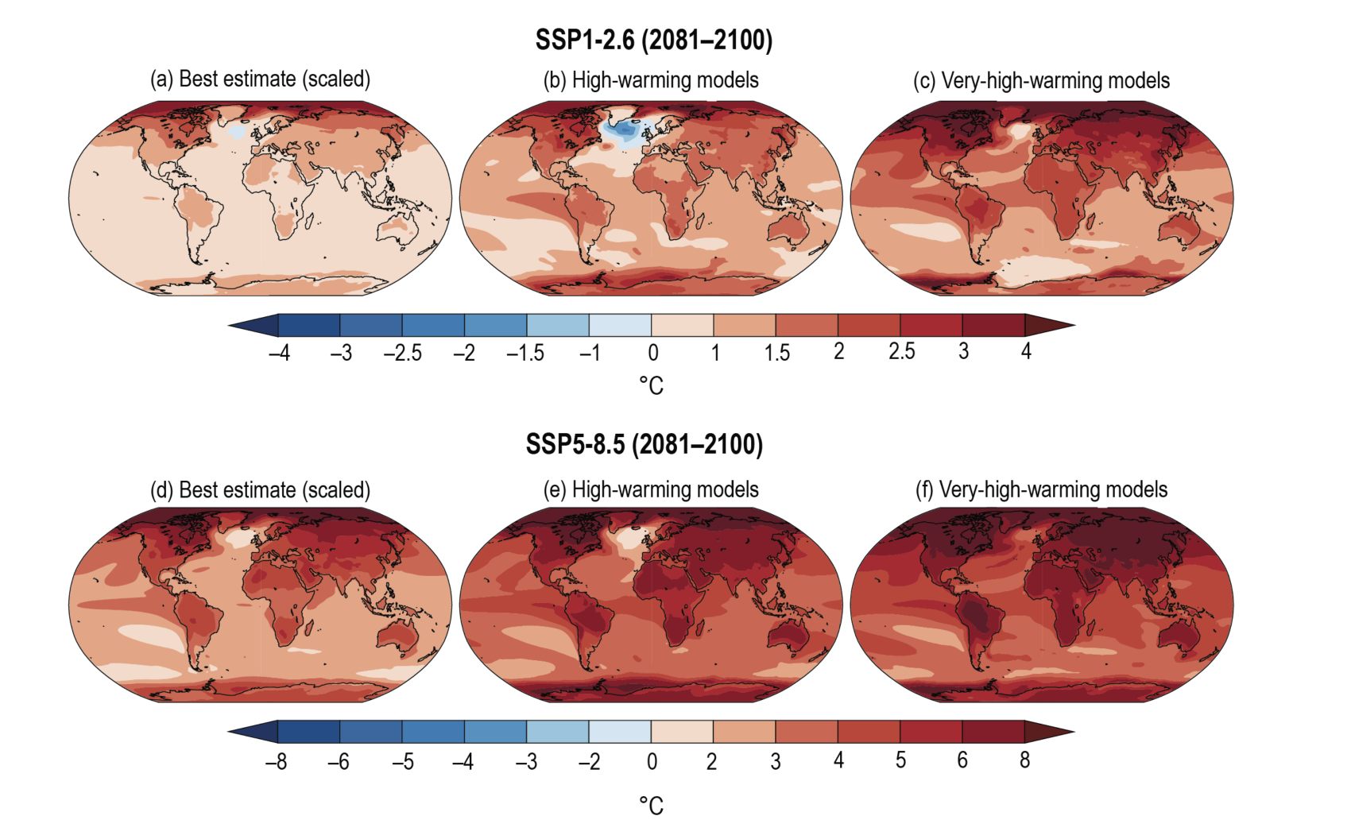
Temperature Measurements: Future

Slide 25
Discussion
Argue against: “The Earth’s climate is always changing and this is nothing to do with humans.”
How might measurements support this argument?

Slide 26
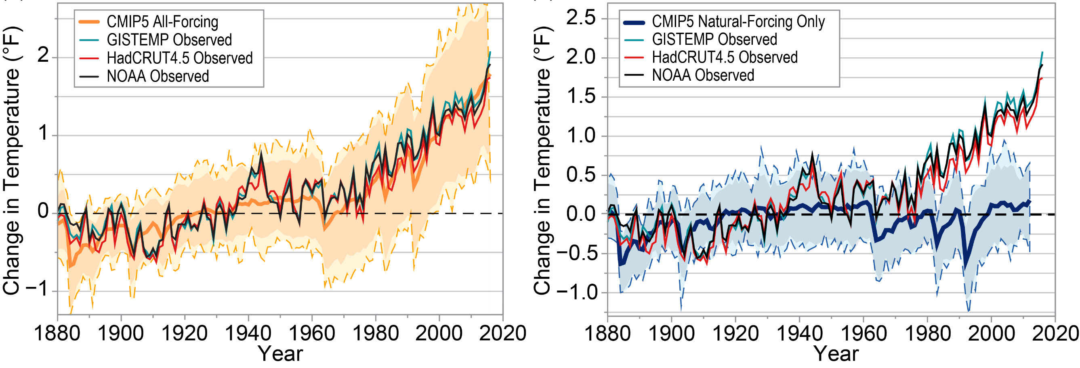
Are humans the cause?
Data
We know temperatures and GHGs are rising from measurements.
Climate models can reproduce past temperature rise well only if human inputs are included.
Scientific Understanding
Greenhouse effect is well established. Logical that if GHGs go up, temperatures will go up too.
We understand other natural drivers of climate change, but they are inconsistent with what we observe.

Slide 27
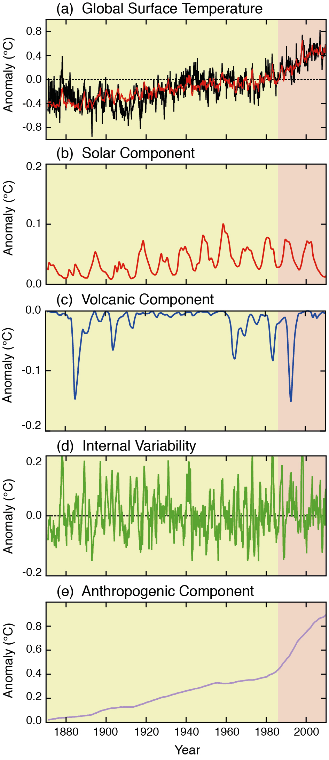
Other drivers of temperature change
FAQ5.1, Figure 1, AR5 Full Report

Slide 28
Other drivers of temperature change
Solar variability
  11-year cycle
  weak long-term trend
FAQ5.1, Figure 1, AR5 Full Report

Slide 29
Other drivers of temperature change
Solar variability
Volcanoes
  strong, but short-lived impact
  cooling effect
FAQ5.1, Figure 1, AR5 Full Report

Slide 30
Other drivers of temperature change
Solar variability
Volcanoes
Internal variability
  El Niño-Southern oscillation
FAQ5.1, Figure 1, AR5 Full Report

Slide 31
Other drivers of temperature change
Solar variability
Volcanoes
Internal variability
Anthropogenic impacts
FAQ5.1, Figure 1, AR5 Full Report

Slide 32
Are humans the cause?
Other drivers of temperature change
Solar variability
Volcanoes
Internal variability
Anthropogenic impacts
Put all these together, and the only component to have a sustained increased throughout this period is the anthropogenic one.

Slide 33
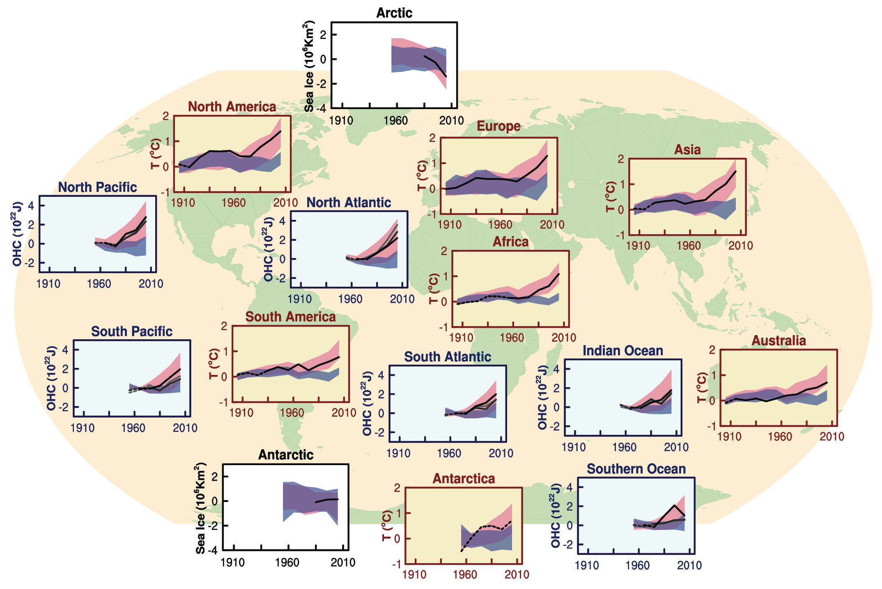
Are humans the cause?
“It is now very likely that human influence has contributed to observed global scale changes in the frequency and intensity of daily temperature extremes since the mid-20th century, and likely that human influence has more than doubled the probability of occurrence of heat waves in some locations.” IPCC

Slide 34
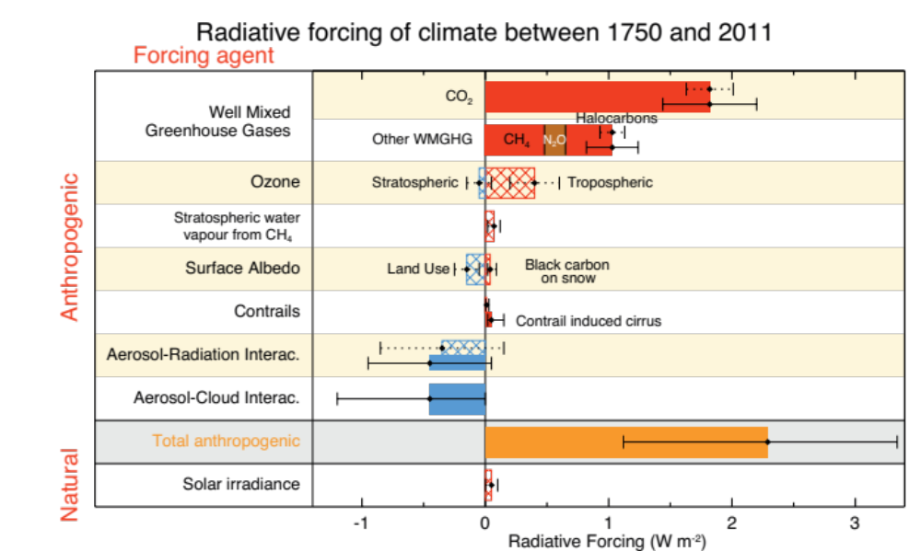
Latest understanding
Are humans the cause?
IPCC (paraphrased)
Concentrations of greenhouse gases increased markedly
Most of observed temperature increase since mid-20th century very likely (90%) due to human-induced greenhouse gas increases
CO₂ primarily due to fossil fuel use
Methane & Nitrous Oxide due to agriculture
Very high confidence (90%) that average impact of humans has been warming
Warming unequivocal
Sea level rise unequivocal
Melting of snow and ice unequivocal

Slide 35
Measurements Summary
All climate measurements contain uncertainty, arising from instrument limits, calibration, and interpretation.
Uncertainty increases further back in time:
  Instrumental records (last ~150 years): high accuracy, high temporal resolution
  Historical records: lower accuracy and lower temporal resolution
Temporal resolution decreases with age:
  Ice cores: annual layers near the surface → multi-decadal to millennial averaging at depth
  Marine & lake sediments: often integrate signals over centuries or longer
Climate proxies have intrinsic uncertainties:
  Proxies (e.g. tree rings, ice cores, corals, sediments) record indirect climate signals
  Each proxy responds to multiple environmental factors, not just temperature e.g. tree rings reflect moisture, nutrients, CO₂, and disturbance as well as temperature

Slide 36

Remaining Uncertainties
Whilst we are very certain that anthropogenic forcings are driving the climate change we are seeing, our understanding of global climate change is not perfect
Here we will discuss some remaining uncertainties we have…..some of that come from measurements
Data gaps
We have more measurements...
  now than in the past,
  close to the surface compared to higher up
  Top of the ocean vs bottom
  of ‘simpler’ variables (temperature, pressure) compared to ice, tree cover, etc.
  over land compared to the ocean, and in the northern hemisphere, compared to the tropics and southern hemisphere.

Slide 37
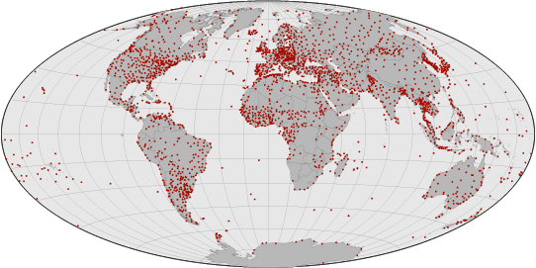
Measurement Uncertainties
Data gaps
Ground station coverage (image from NASA)

Slide 38
Measurement Uncertainties
Data gaps
Representativity
Ground station coverage (image from NASA)

Slide 39
Measurement Uncertainties
Data gaps
Representativity

Slide 40
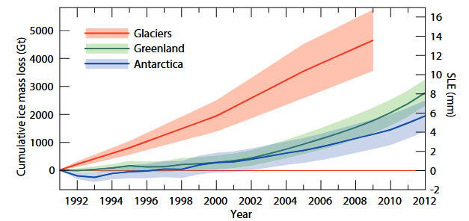
Measurement Uncertainties
Data gaps
Representativity
Indirect measurements
  Climate proxies
  Satellite data

Slide 41
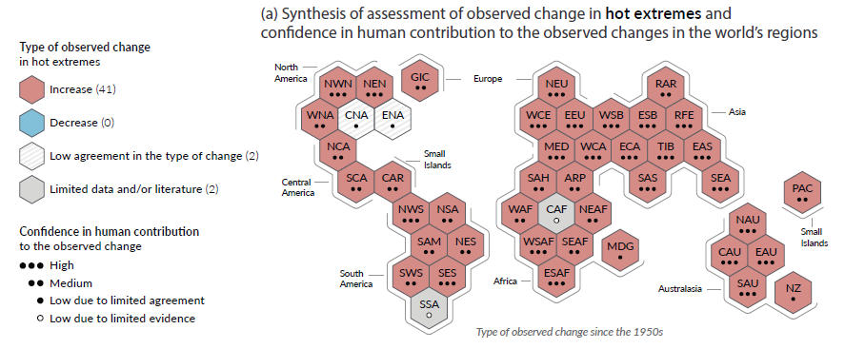
Natural Variability
Some quantities vary more due to natural causes
harder to attribute changes to human causes

Slide 42
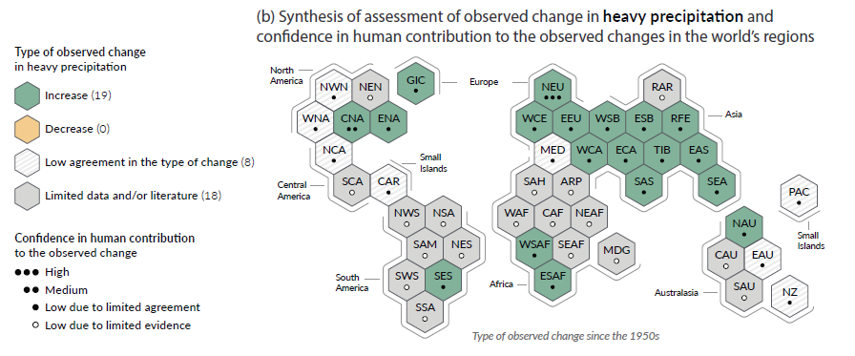
Natural Variability
Some quantities vary more due to natural causes
harder to attribute changes to human causes

Slide 43
Natural Variability
Some quantities vary more due to natural causes
harder to attribute changes to human causes
Most quantities vary more at smaller than larger scales
Less certainty on local changes compared to global changes

Slide 44
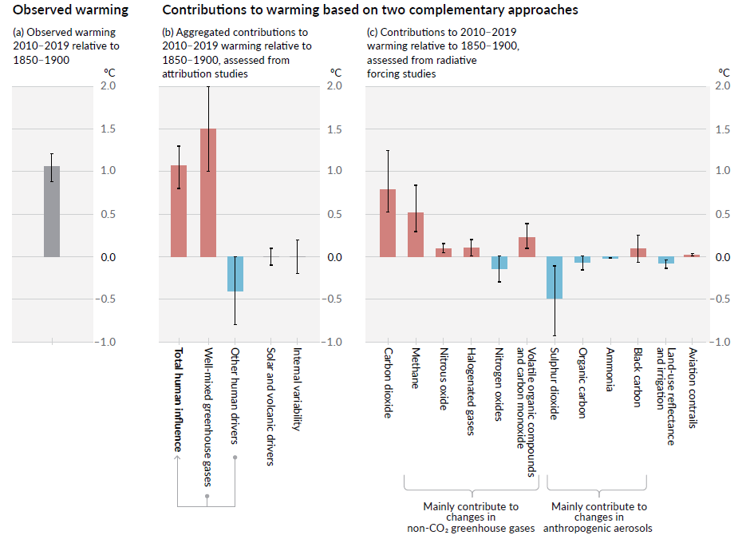
Scientific Understanding
Greenhouse gases
Aerosols
Drivers of change

Slide 45
Scientific Understanding
Drivers of change
Internal Feedbacks
  Clouds/precipitation
  Cryosphere
  Biosphere
Earth/Atmosphere is delicate balance, largely dictated by incoming and outgoing radiation
Slight changes in balance can cause large changes in global climate
These changes can be enhanced or diminished by positive or negative feedbacks
Positive feedback: initial change reinforced by another process.
Negative feedback: initial change counteracted by another process.

Slide 46
Radiative Forcing
Definition of radiative forcing:
The change in radiation balance at the tropopause between the incoming solar radiation and the outgoing earth’s radiation (net irradiance).
A positive forcing warms the climate system
A negative forcing cools the climate system
Significance:
Increase in greenhouse gases has reduced the amount of longwave radiation leaving the troposphere –positive radiative forcing.
In the real atmosphere there are a number of positive and negative feedbacks that will occur and interact non-linearly with each other.

Slide 47

Climate Feedback – Positive Examples
Climate feedbacks describe how components of the Earth system respond to an initial forcing, either reinforcing or counteracting the resulting climate change.
(Processes that amplify an initial climate change)
Ice–albedo feedback
Melting ice and snow reduce surface albedo, causing more solar radiation to be absorbed and further warming.
Water vapour feedback
Warmer air holds more water vapour, a powerful greenhouse gas, which enhances the greenhouse effect.
Ocean carbon feedback
As seawater warms, the oceans’ capacity to dissolve CO₂ decreases, leaving more CO₂ in the atmosphere.
Vegetation–albedo feedback (regional)
Expansion of darker vegetation (e.g. forests into high latitudes) lowers surface albedo, increasing heat absorption.

Slide 48

Climate Feedback – Negative Examples
Climate feedbacks describe how components of the Earth system respond to an initial forcing, either reinforcing or counteracting the resulting climate change.
(Processes that counteract an imposed climate change)
CO₂ fertilisation effect
Higher atmospheric CO₂ can enhance plant growth, increasing carbon uptake through photosynthesis.
Increased terrestrial carbon storage
Warmer temperatures in some regions lengthen growing seasons, allowing greater carbon storage in soils and biomass.
Chemical weathering feedback
Higher temperatures and increased rainfall enhance silicate rock weathering, which removes CO₂ from the atmosphere over long timescales.

Slide 49
Climate Models
Measurements
Internal variability
Scientific understanding
4. Climate model uncertainty
More certain
Less certain
Global Regional Local changes
Temperature Precipitation Other Earth-system changes
Near past/future Far past/future

Slide 50
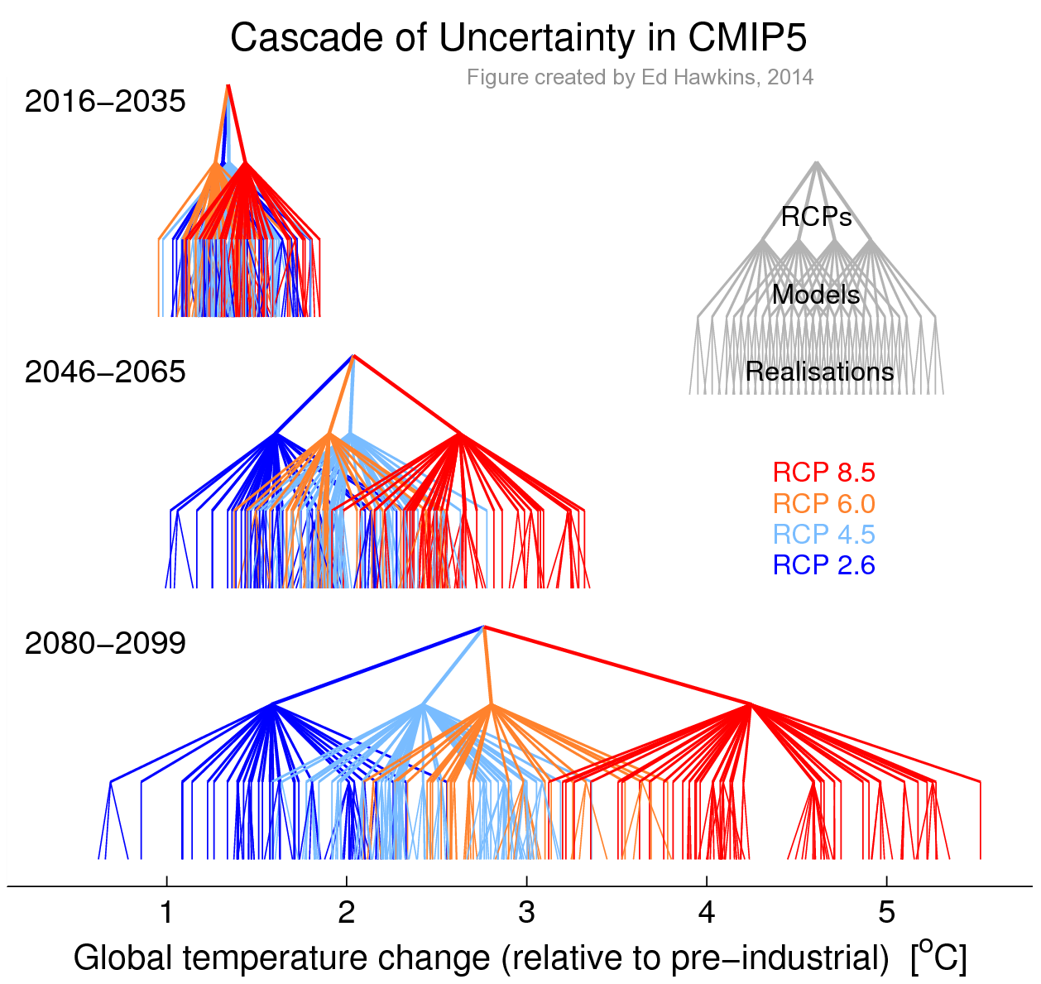
Climate Models - Uncertainties
Week 7

Slide 51
Lecture Summary
Multiple independent datasets (instrumental records, satellites, ice cores, and proxies) consistently show rising CO₂ concentrations and global temperatures across timescales from decades to millions of years.
Modern CO₂ levels (~420 ppm) are unprecedented for at least 800,000 years and likely far longer, with isotopic evidence confirming a fossil-fuel (anthropogenic) origin.
Temperature increases since the mid-20th century are best explained by human greenhouse gas emissions; natural drivers (solar variability, volcanoes, internal variability) cannot account for the observed long-term warming.
Radiative forcing theory links increased greenhouse gases to warming, while feedbacks (especially water vapour and clouds) amplify or modulate the response.
Uncertainty increases backward in time and at smaller spatial scales, but confidence is very high that human activity is the dominant cause of recent global warming.

Slide 52
Example Exam Questions
Describe the sources of observational evidence used to reconstruct past atmospheric CO₂ concentrations
Explain how direct atmospheric CO₂ measurements are made?
What information do ice cores provide about past climates, and what are the key limitations?
Define a climate proxy and explain why multiple proxies are needed to reconstruct past climate conditions.
Compare and contrast instrumental temperature records with proxy-based temperature reconstructions.
Discuss the evidence that current atmospheric CO₂ concentrations are anomalous in the context of the last 800,000 years.
Outline the main lines of evidence indicating that recent climate change is primarily anthropogenic in origin.
Why are natural climate drivers insufficient to explain the observed warming since the mid-20th century?
Define radiative forcing and explain its importance in understanding climate change.
Explain the difference between positive and negative climate feedbacks, giving one example of each.
Explain why uncertainty in climate data increases further back in time and at smaller spatial scales.
Discuss why global-scale temperature changes are generally better understood than regional or local climate changes.

Slide 53
Global Climate Change - 2026
Week 1 – Introduction to climate change and its impacts (5th Feb)
Week 2 – Natural climate variability (12th Feb)
Week 3 – Radiation Law/Greenhouse Effect/Radiative forcing/feedbacks (19th Feb)
Week 4 – Anthropogenic impacts (26th Feb)
Week 5 – The Evidence Base for Climate Change (5th March)
Week 6 – Mid Unit Test (10th March)
Week 7 – Climate Models (19th March)
Week 8 – Climate Change Adaptation (26th March)
Week 9 – Effects of Climate Change: Case Studies (23rd April)
Week 10 – Climate Change Mitigation (30th April)
Week 11 – Revision Lecture (7th May)
Comments/Questions

Slide 54
Global Climate Change - 2026
Week 6 – Mid Unit Test (10th March)
This assessment will test your understanding of weeks 1-5 of the Global Climate Change Course
The test must be completed and submitted in person under examination conditions.
When: 10th March, 14:00–15:00/15:30
Where: Room 6.004, Simon Building – Computer Cluster/DASS Students - Mansfield Cooper 2.01
Please arrive 10–15 minutes early so you have time to log in to Canvas before the test begins.
The test comprises 25 multiple choice questions. Only one submission is allowed per student (multiple attempts are not allowed). Submit using the 'Submit' button, but only do this when you are ready to finish the test as you cannot make repeat submissions.
For questions that are multiple answers (rather than multiple choice): Partial credit is calculated by dividing the total points possible by the number of correct answers for the question. This amount is awarded for each correct answer selected and deducted for each incorrect answer selected. No points are awarded or deducted for answers that are not selected. Zero is the lowest possible score.

Slide 55
Week 7: Climate Models
In week 7 we will focus on climate models and how they are used to understand past, present, and future climate change.
By the end of that lecture, you will be able to:
Explain why climate models are essential tools for studying and projecting climate change
Identify the main components of global climate models and describe how they interact
Discuss key sources of uncertainty in climate models, and how hindcasting is used to assess their reliability
Distinguish between natural climate variability and anthropogenic climate change
Explain how Representative Concentration Pathways (RCPs) are used to explore possible future climates

Slide 56
Global Climate Change
Week 5 – Questions and Answers
Dr Thomas Bannan
Thomas.Bannan@Manchester.ac.uk

Slide 57
Q1.
Critically compare instrumental records, ice cores, and proxy data.
Which type of evidence do you find most convincing, and why?
How does agreement between independent datasets increase confidence?
Are there any datasets you would trust less? On what basis?

Slide 58
Q2.
Where does uncertainty in climate data come from?
Which aspects of climate change are well understood, and which are not?
How should scientists communicate uncertainty without weakening the message?

Slide 59
Q3.
Why are global trends easier to detect than local changes?
How does internal variability complicate short-term or regional analysis?
What are the implications for adaptation planning at local scales? (we will think more about this in week 8)

Slide 60
Q4.
How do scientists separate human influences from natural variability?
Why are climate models essential for attribution?
What would the climate record look like if warming were purely natural over the last 100 years?

Slide 61
Q5.
If CO₂ is well mixed in the atmosphere, why do we measure it at remote sites like Mauna Loa or the South Pole?

Slide 62
Q6.
Why do we need multiple climate proxies rather than relying on just one “best” proxy?

Slide 63
Q7.
If solar variability were responsible for modern warming, what would the vertical temperature profile look like?

Slide 64
Q8.
Why does uncertainty increase further back in time and at smaller spatial scales?

